Slide 1
Stitch Aware Detailed Placement for Multiple E-Beam Lithography
Yibo Lin¹, Bei Yu², Yi Zou^{1,3}, Zhuo Li⁴,
Charles J. Alpert⁴, and David Z. Pan¹
¹ECE Department, University of Texas at Austin
²CSE Department, Chinese University of Hong Kong
³CEAS Department, Nanjing University
⁴Cadenace Design Systems, Inc.
This work is supported in part by NSF and SRC
Notes:
1

Slide 2
Outline
8/31/15
2
Introduction
Previous Work
Problem Formulation
Stitch Aware Detailed Placement
Experimental Results
Conclusion
Notes:
2

Slide 3
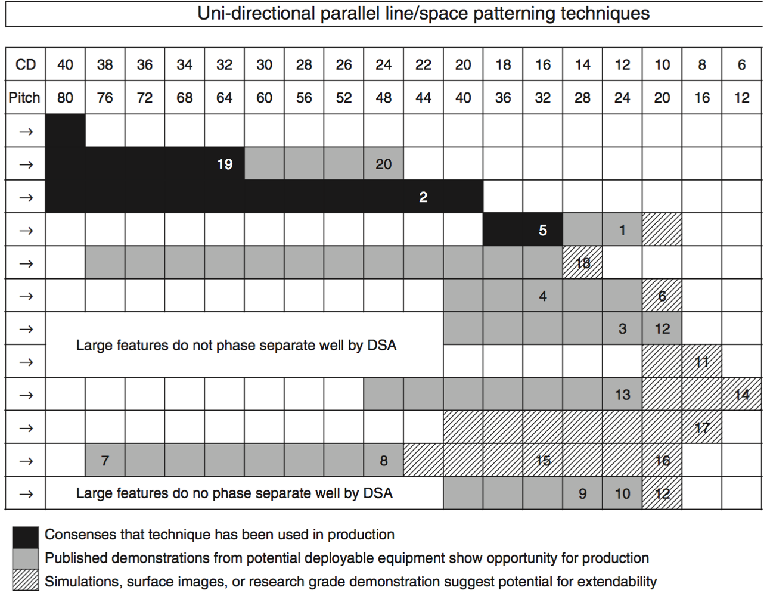
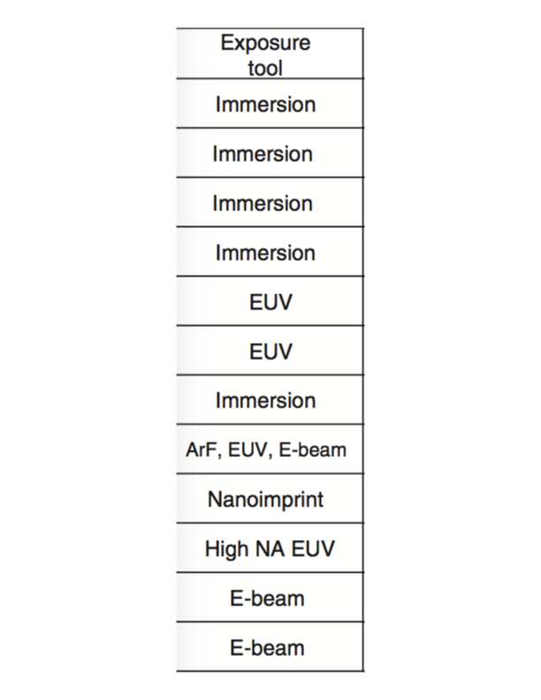
Introduction
Technology Scaling
[Courtesy ITRS]

Slide 4
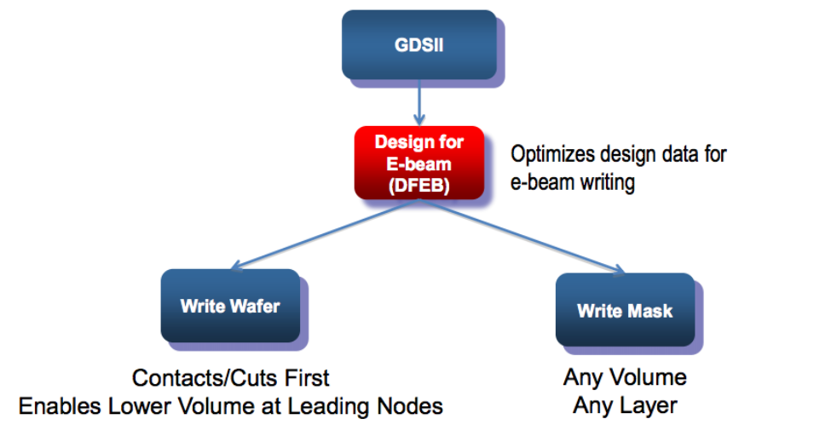
E-Beam Lithography
Direct-write or mask?
[Courtesy E-beam Initiative]

Slide 5
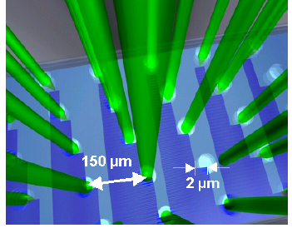
Multiple E-Beam Lithography
Massively-Parallel e-beam writing
Each stripe has width of 50~200 microns
Stitching region has a width around 15nm [Berg+,SPIE’11]
Field stitching
[Fang+,DAC’13]
MAPPER Lithography System

Slide 6
Field Stitching
SEM figures showing stitches at boundaries of beam stripes
Holes
Lines

Slide 7
Previous Work
Stitch aware routing for MEBL
[Fang+,DAC’13], [Liu+,TCAD’15]
TPL aware placement
[Yu+,TCAD’15], [Kuang+,TVLSI’15], [Chien+,TCAD’15]
[Tian+,ICCAD’14], [Lin+,ISPD’15]
TPL applies different constraint to placement from MEBL
No placement algorithm addressing MEBL stitch constraint yet

Slide 8
Stitch Errors
Defects on vias and vertical wires
Defects on short polygons
[Fang+,DAC2013]

Slide 9
Stitch Errors within Standard Cell
Resolve stitch errors by proper placement

Slide 10
Dangerous Site Representation
A cell is divided into sites (poly pitch)
Sites that contain susceptible segments are marked as “dangerous sites”

Slide 11
Problem Formulation
Input
Initial placement
Dangerous site information for each standard cell (precomputed)
Output
New placement with optimized wirelength and minimum stitch errors
MEBL friendliness

Slide 12

Single Row Placement & Previous Work
Given a set of ordered cells c₁, c₂, …, c_{n}, place cells horizontally to minimize objectives such as wirelength or movement
Previous work on single row algorithm
Conventional objectives
[Brenner+,DATE’00], [Kahng+,GLSVLSI’04], Abacus [Spindler+,ISPD’08], [Taghavi+,ICCAD’10]
TPL awareness
[Yu+,ICCAD’13]: O(mnK)
[Kuang+,ICCAD’14]
Note: $τ=10, φ=1, υ=1$ in the experiment

Slide 13
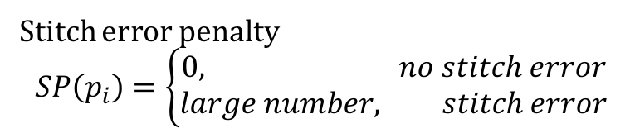
Single Row Placement
Given a set of ordered cells c₁, c₂, …, c_{n}, with maximum cell displacement M
Minimize wirelength and stitch errors
An algorithm supports a cost function generalizes wirelength, movement and stitch errors
Movement
$${cost}_{i}\left(p_{i}\right)=τ∙WL\left(p_{i}\right)+φ∙MOV\left(p_{i}\right)+ν∙SP(p_{i})$$
Wirelength cost
Stitch error penalty
$$SP\left(p_{i}\right)=\left\{\begin{aligned}0, no stitch error \\ large number, stitch error\end{aligned}\right.$$
Note: $τ=10, φ=1, υ=1$ in the experiment

Slide 14
Single Row Placement
Given a set of ordered cells c₁, c₂, …, c_{n}, with maximum cell displacement M
Shortest path solved by dynamic programming
O(nM²)
M < 10?
M > 30?

Slide 15
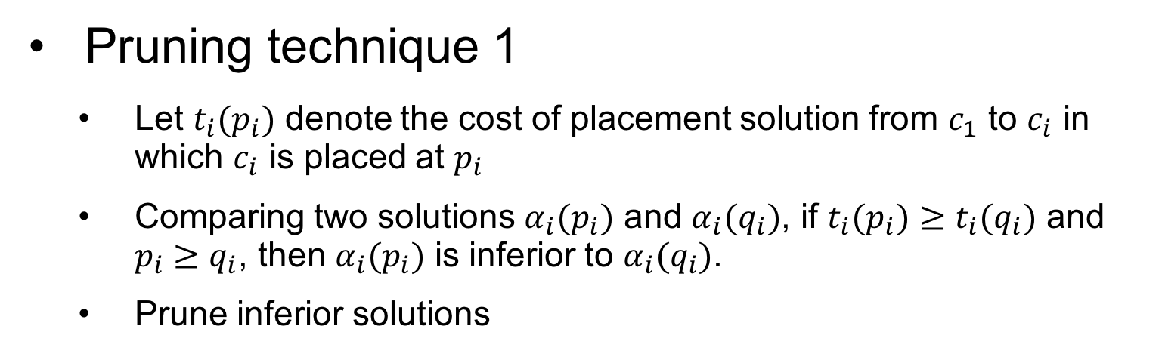
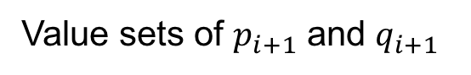
Speedup with Pruning Techniques
Pruning technique 1
Let $t_{i}(p_{i})$ denote the cost of placement solution from $c_{1}$ to $c_{i}$ in which $c_{i}$ is placed at $p_{i}$
Comparing two solutions $α_{i}(p_{i})$ and $α_{i}(q_{i})$, if $t_{i}(p_{i})≥t_{i}(q_{i})$ and $p_{i}≥q_{i}$, then $α_{i}(p_{i})$ is inferior to $α_{i}(q_{i})$.
Prune inferior solutions
Value sets of $p_{i+1}$ and $q_{i+1}$

Slide 16
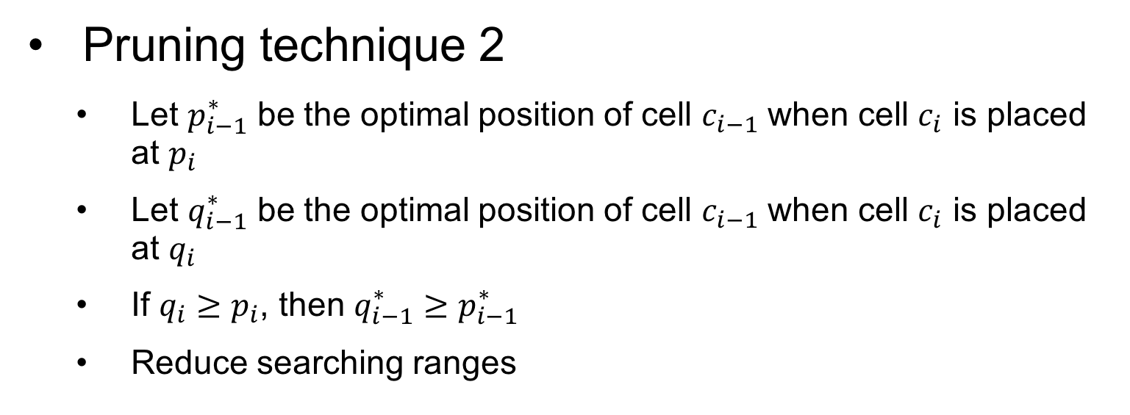
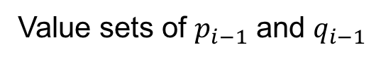
Speedup with Pruning Techniques
Pruning technique 2
Let $p_{i−1}^{∗}$ be the optimal position of cell $c_{i−1}$ when cell $c_{i}$ is placed at $p_{i}$
Let $q_{i−1}^{∗}$ be the optimal position of cell $c_{i−1}$ when cell $c_{i}$ is placed at $q_{i}$
If $q_{i}≥p_{i}$, then $q_{i−1}^{∗}≥p_{i−1}^{∗}$
Reduce searching ranges
Value sets of $p_{i−1}$ and $q_{i−1}$

Slide 17
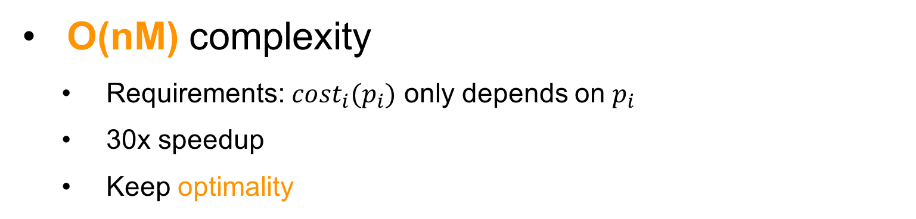
Effectiveness of Speedup Techniques
O(nM) complexity
Requirements: ${cost}_{i}(p_{i})$ only depends on $p_{i}$
30x speedup
Keep optimality

Slide 18

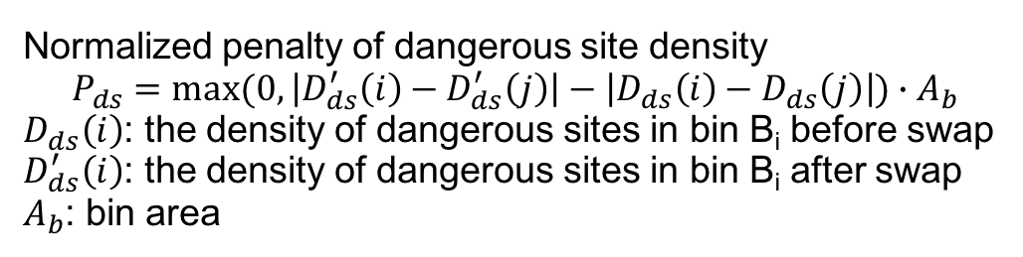
Resolve Stitch Errors in Dense Regions
Global swap to smooth out density
$score\left(c_{i},c_{j}\right)=∆sHPWL−λ∙P_{ds}−μ∙P_{ov}$
Overlap penalty
sHPWL change
Normalized penalty of dangerous site density
$$P_{ds}=max⁡(0, \left|D_{ds}^{′}\left(i\right)−D_{ds}^{′}\left(j\right)\right|−\left|D_{ds}\left(i\right)−D_{ds}\left(j\right)\right|)∙A_{b}$$
$D_{ds}\left(i\right)$: the density of dangerous sites in bin B_{i} before swap
$D_{ds}^{′}\left(i\right)$: the density of dangerous sites in bin B_{i} after swap
$A_{b}$: bin area
Achieve better density of dangerous sites
Note: $sHPWL=HPWL×(1+α×P_{ABU})$ from ICCAD 2013 Contest

Slide 19
Overall Flow

Slide 20
Experimental Environment Setup
Implemented in C++
8-Core 3.4GHz Linux server with 32GB RAM
ICCAD 2014 contest benchmark
Mapped to Nangate 15nm Standard Cell Library
Legalized with RippleDP [Chow+,ISPD’14]
Design | #cells | #nets | #blockages
vga_lcd | 165K | 165K | 0
b19 | 219K | 219K | 0
leon3mp | 649K | 649K | 0
leon2 | 794K | 795K | 0
mgc_edit_dist | 131K | 133K | 13
mgc_matrix_mult | 155K | 159K | 16
netcard | 959K | 961K | 12

Slide 21
Experimental Results
Wirelength Improvement %
Final Stitch Errors
Init.: initial input placement
SR: single row algorithm only
Full Flow: apply full flow including single row algorithm and global swap

Slide 22
Runtime Comparison
Full flow is slightly slower than SR
Only apply to regions still containing stitch errors
Runtime (s)

Slide 23
Conclusion
Methodology to handle e-beam stitch errors during detailed placement stage
A linear time single row algorithm with highly-adaptable objective functions
Better EBL friendliness
Future work
Consider interaction between placement and routing for EBL friendliness

Slide 24
Thanks

